Slide 1
E Commerses WebSite
Theme –Car Selling website Like car dekho

Slide 2
Website
New User
Existing User
Seller
Buyer
Seller
Buyer
New Car
Old Car
Add/Remove Car
New Car
Old Car
New Car
Old Car
Add/Remove Car
New Car
Old Car

Slide 3
Home page

Slide 4
Nev Bar
Logo -done
Search- done
Wishlist- done
Login/Register- done
Demo
Language Change

Slide 5





Sub nev bar
New Car
Used Cars
Reviews
Select City
Demo
Video

Slide 6
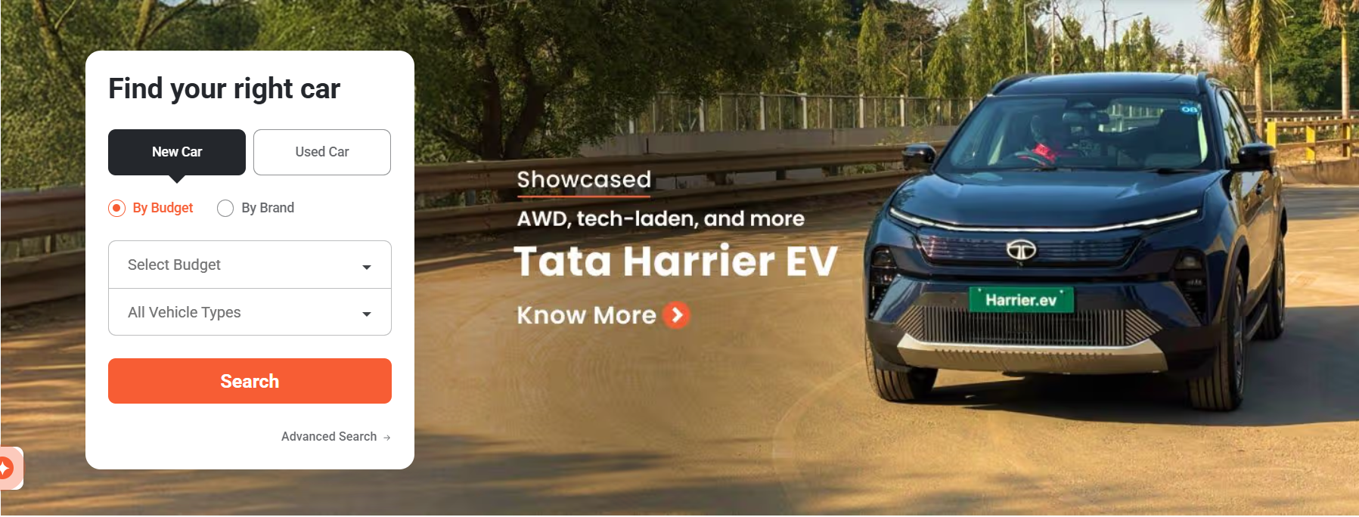
Next Part Body

Slide 7
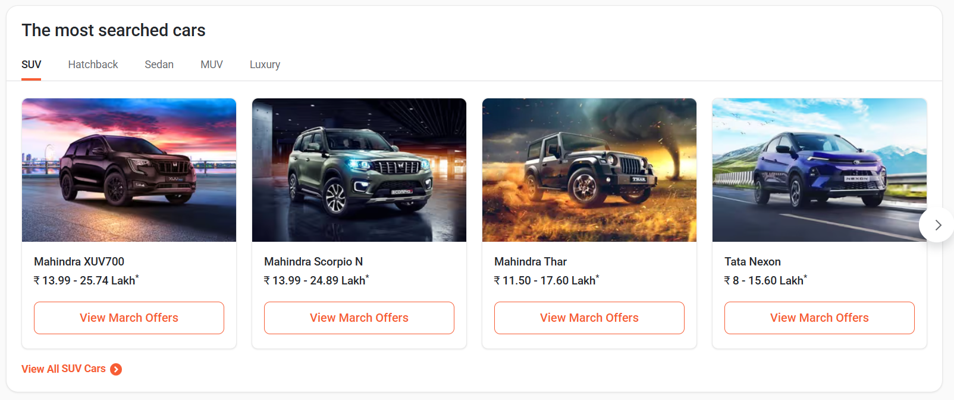

Slide 8
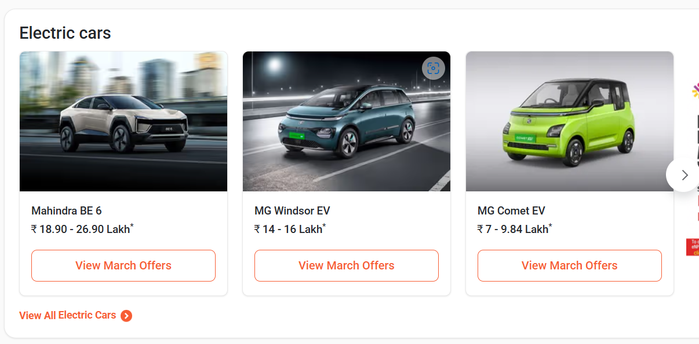

Slide 9
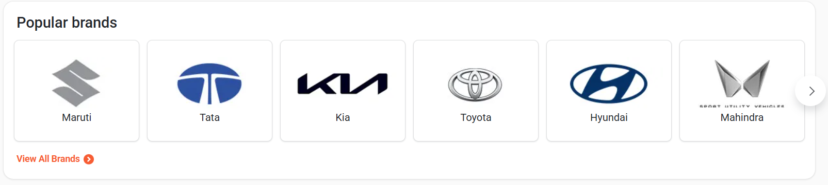

Slide 10
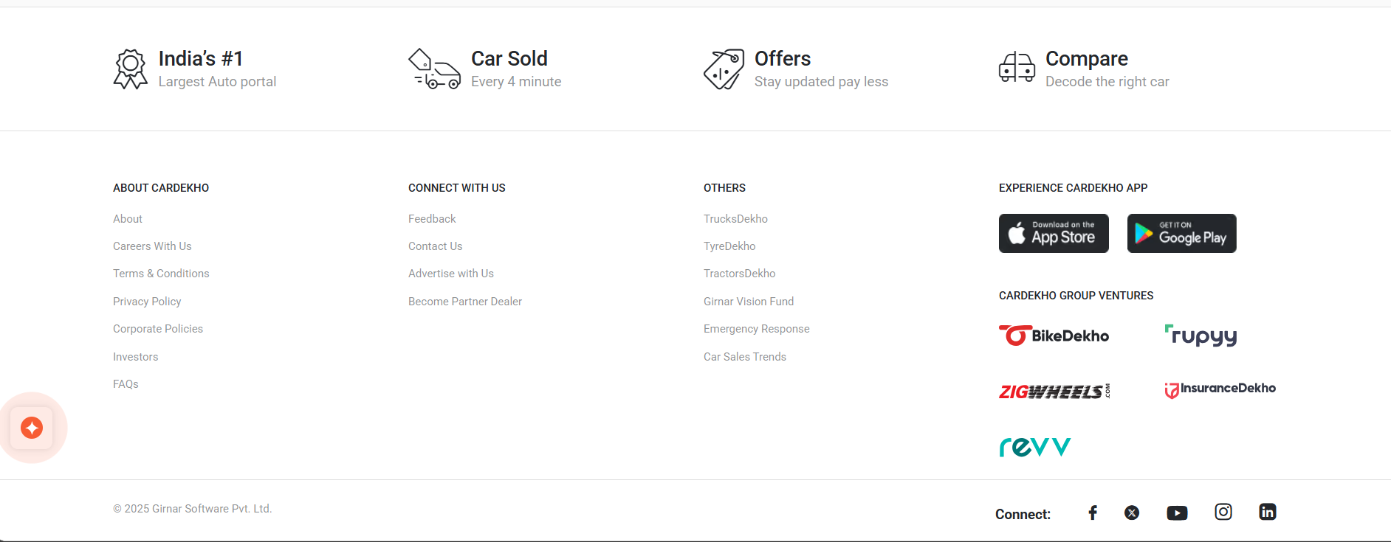

Slide 11
Login/ Register

Slide 12
Login
Database
Code
Username
Password
Div
Js-> onclick
In to the div write create new account(register)

Slide 13
Register
Database
Code
Username
Userid
Password
Mobile Number
Mail
Location
Buyer/Seller
Render from login div
Div
All elements of database insert
Submit

